Slide 1


A CAREER IN..
NUCLEAR MEDICINE

Slide 2
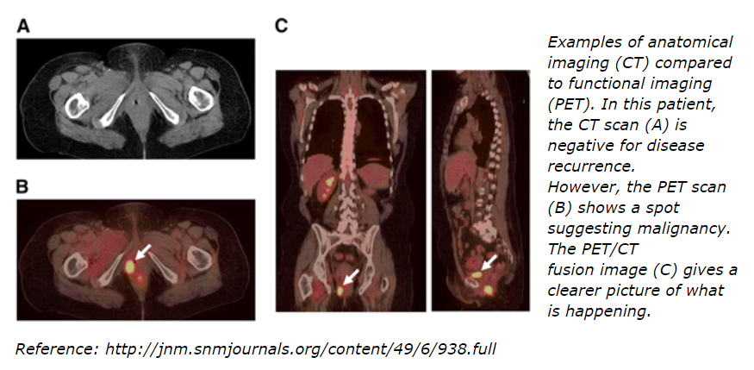
Let’s Take a Look…

Slide 3
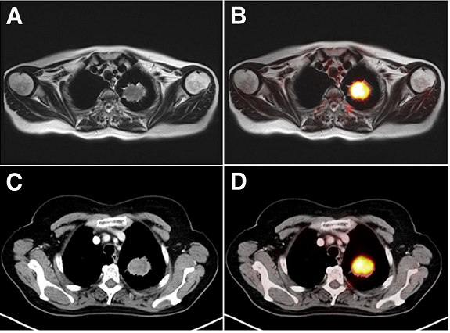
Let’s Take a Look…
59 y-o female patient
non-small cell lung cancer shown above.
(A) T2-MR scan
(B) Fused ¹⁸F-FDG PET/MR scan
(C) CT scan
(D) ¹⁸F-FDG PET/CT scan
Tumor was correctly staged as T2a tumor.
Source: http://jnm.snmjournals.org/content/55/3/373.full

Slide 4
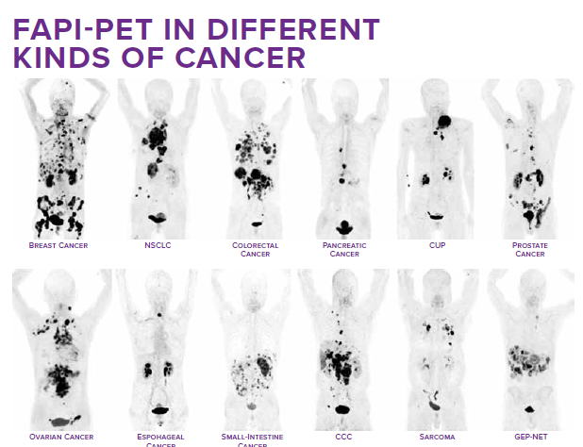
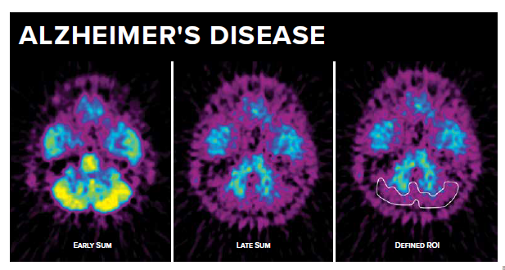
Let’s Take a Look…
Developing new tracers and software will allow for more precise imaging and treatment based on the specific characteristics of the patient’s disease.

Slide 5
Career Opportunities Within Nuclear Medicine
Career Opportunities
Physician
Technologist
Physicist
Radiochemist
Radiology Program Manager
Clinical Coordinator
Industry
Private Practice
Administrator
Program Director
Military
Research (Preclinical)
International
Management
And more…
Work environment
Nuclear Medicine and Molecular Imaging Professionals work in a wide variety of clinical settings, such as:
Community hospitals
University-affiliated teaching hospitals and medical centers
Outpatient imaging facilities
Public health institutions
Government and private research institutes
Institutions (educators)
Industry
Research
Lab

Slide 6

Want More Information?
From discovering the field to maintenance of certification, the Society of Nuclear Medicine and Molecular Imaging (SNMMI) is here to provide you resources and a community throughout your entire career in nuclear medicine and molecular imaging!
www.snmmi.org

Slide 7


Why Join SNMMI Now?
SNMMI membership offers an unparalleled opportunity to partake in peer-to-peer learning, networking, and collaboration.
Local Chapters
SNMMI chapters are assigned to members within the USA and Canada to provide additional resources and networking opportunities at the local level. Chapters allow members to connect with peers in a regional setting while working on issues unique to their local area.
Councils and Centers
Enhance your network through affiliation with an SNMMI council or center of excellence. These groups provide professional networking and educational programs in various specialty areas.
14,000+ members
Representing 90+ countries
13 domestic chapters
9 specialty councils
3 centers of excellence
… And 1 member like YOU!

Slide 8
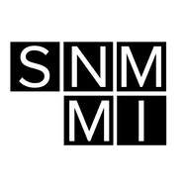




SNMMI-TS Student Transition Program
FIRST 5 YEARS OUT OF PROGRAM
Students that participated in the free SNMMI-TS trial program, who graduated in the past 6 months, and can present credentials indicating professional activity in molecular imaging or nuclear medicine technology or other related fields. This reduced price is available for five years after graduation as long as there is no lapse in membership.
ANNUAL DUES: $58.50 + CHAPTER DUES
Online Subscriptions to The Journal of Nuclear Medicine and Journal of Nuclear Medicine Technology and UPTAKE.
Can be elected as an officer of the SNMMI-TS and Voting Rights in SNMMI-TS

Slide 9
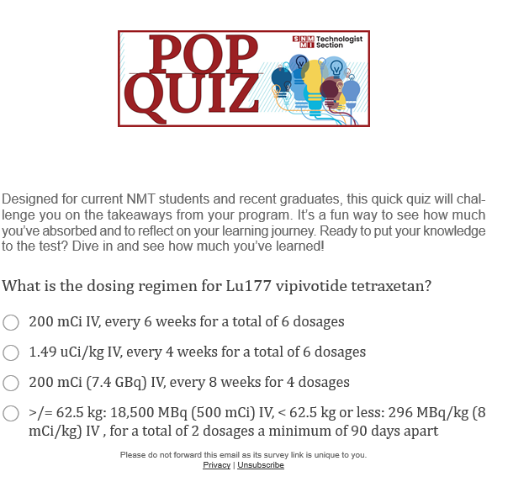
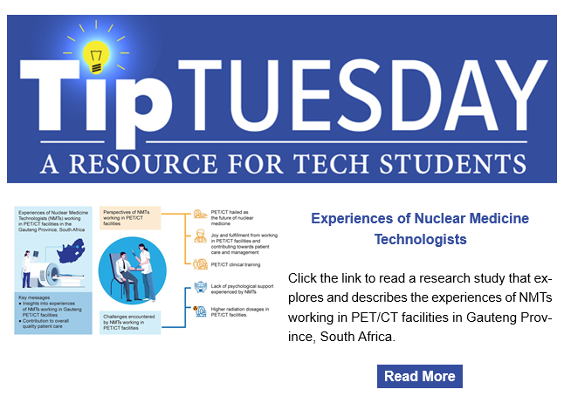
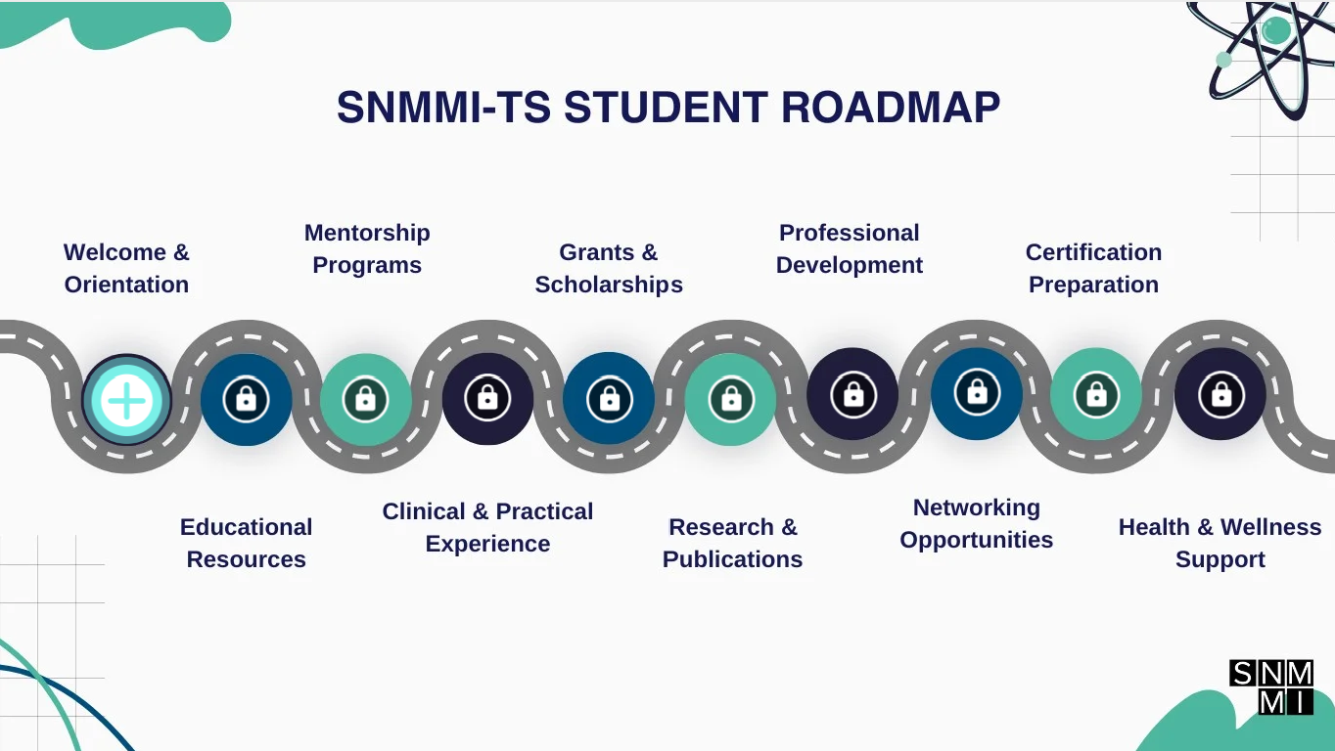
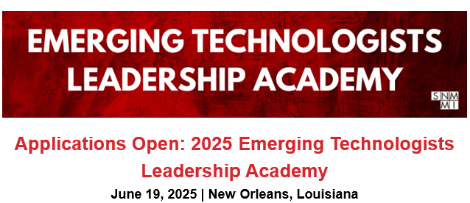
Resources for NMT Students

Slide 10
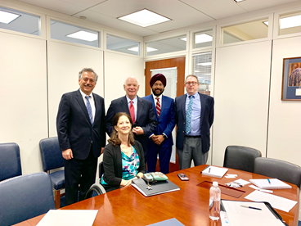
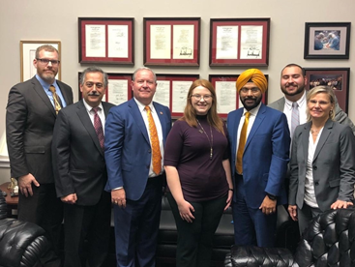
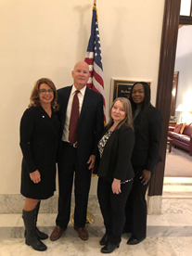
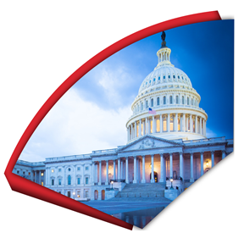
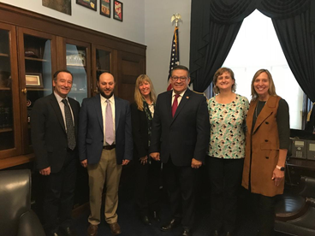
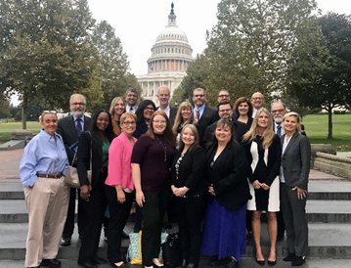
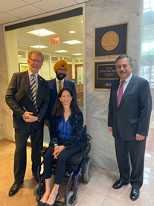
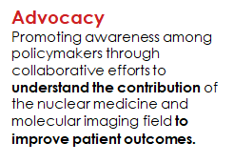
Why Join Now? Meeting with Congressional Leaders

Slide 11

SNMMI-TS Advocacy Efforts
  Coordinating with ARRT, ASRT, and other societies on various NM technologist state licensure initiatives.
  Washington, DC: DC B 25-0545- Health Occupations Revision Act of 2023 was put into law on January 1st, 2025. This act established DC as a licensure district.
  North Carolina: We have worked with ARRT, ASRT, and other societies to create a licensure bill for the 2025 North Carolina legislative session. We expect to introduce this bill in the North Carolina House in January or February of 2025.
  Pennsylvania: ASRT, ARRT, SNMMI, and other organizations circulated a licensure bill in the Pennsylvania Senate in 2024. The bill did not make it our of committee. We expect to reintroduce the bill in 2025.
  California: In Fall of 2024, SNMMI-TS was made aware of an issue in California public health regulations stating that nuclear medicine procedures could only be administer orally. This was not being enforced in California, but the regulation still needed to be changed. TAGs drafted a letter to the California Department of Public Health (CDPH) asking for a change to the statute. The CDPH responded by drafting an exemption to the rule, taking effect on January 1st, 2025. Nuclear Medicine Technologist can now administer nuclear medicine procedures with no limitations.

Slide 12
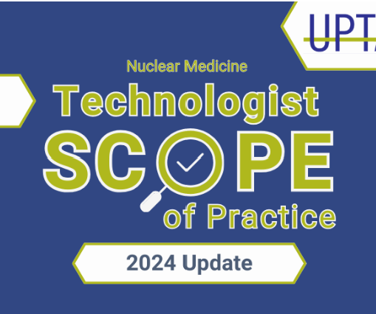
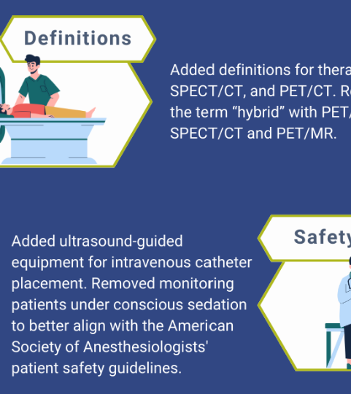
Snmmi.org/scopeofpractice2024

Slide 13
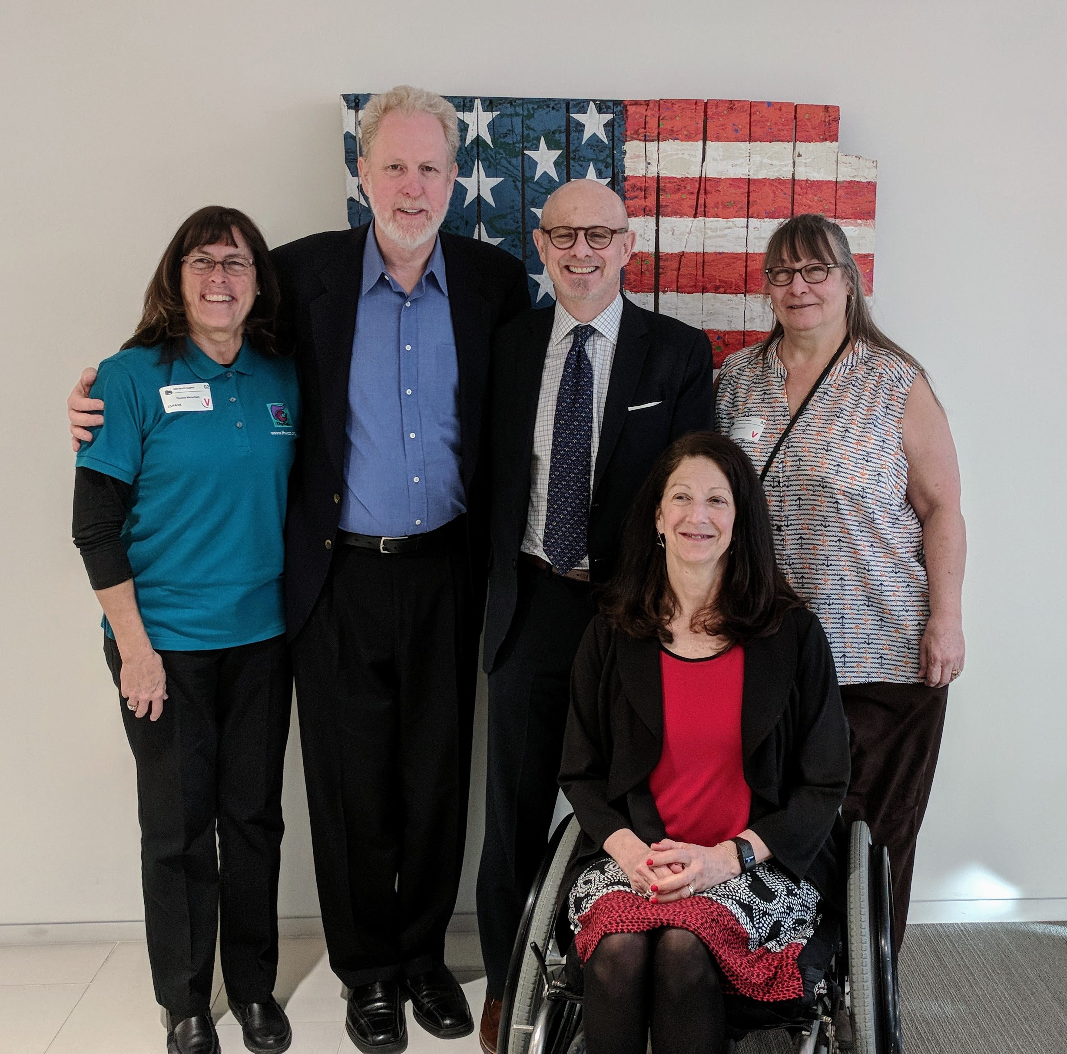
Why Join Now? Outreach to Patients
Patient Advocacy Advisory Board (PAAB)
  SNMMI collaborates with 14 patient advocacy organizations to develop patient-specific programs.
  Advocacy: PAAB members participate in SNMMI
  Hill Days and Virtual Fly-ins.
  Education: More than 1,500 patients and
  caregivers have viewed SNMMI’s 2020
  Virtual Patient Education Day program.
    “On a scale of 1 to 5, how safe do you believe NM and MI procedures are?”
      Before Patient Education Day: Score = 3.4
      After Patient Education Day: Score = 4.4

Slide 14
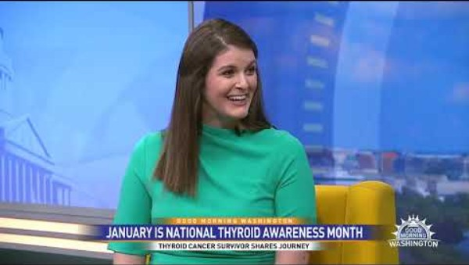
Nuclear Medicine Offers Hope to Cancer Patients

Slide 15
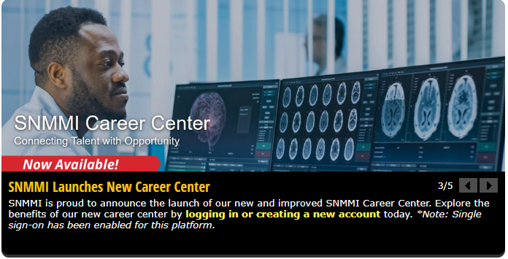
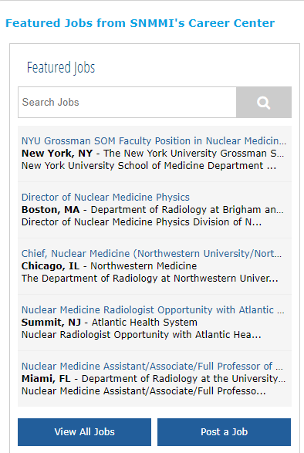
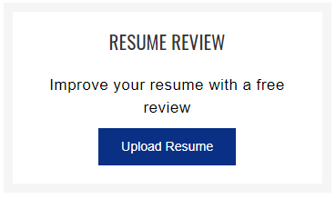

Resources for Students - SNMMI Career Center
Featured jobs appear on SNMMI homepage.
Members can create job alerts (which will be e-mailed DIRECTLY to you).
Members can search the company directory to find jobs where they want to work.

Slide 16
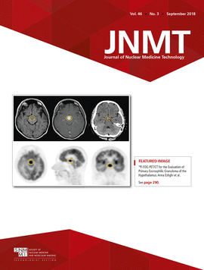
SNMMI-TS Journal
  Journal of Nuclear
  Medicine Technology
    Oriented to meet your needs!
Practitioners from across the imaging sciences turn to JNMT for peer-reviewed information related to daily clinical practice, as well as:
VOICE credit–approved articles for continuing education credit
VOICE credit for authors of published articles
More than 40 years of archived content
Editor’s Page
Continuing Education
Technical Tips
Practical Protocols
Imaging
Radionuclide Therapy
Radiation Safety
Educators’ Forum
Teaching Case Studies
Quality & Practice Management
Professional Development
tech.snmjournals.org

Slide 17
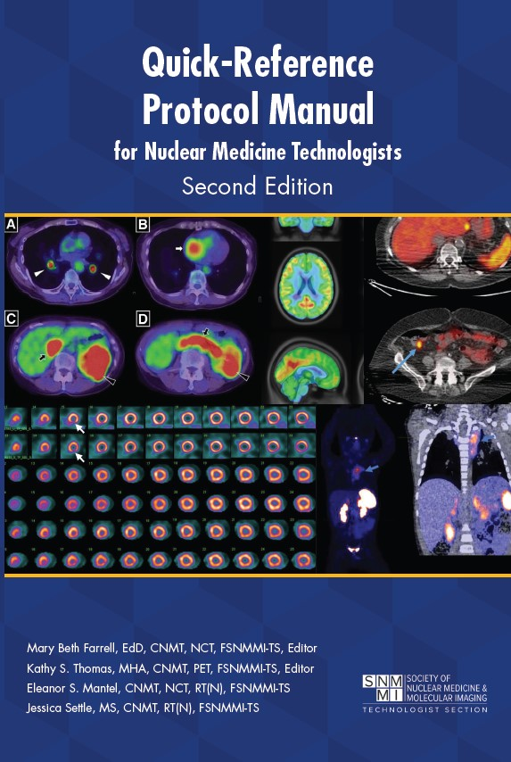
New! Quick-Reference Protocol Manual, 2nd ed.
Cardiovascular System
Central Nervous System
Endocrine System
Gastrointestinal System
Genitourinary System
Hematopoietic, Reticuloendothelial, and Lymphatic Systems
Infection and Inflammation
Labeling
Oncology
Pulmonary System
Skeletal System
Therapy
    Designed for Technologists:
    A practical reference harmonized with accepted guidelines to serve the practical needs of technologists.
    Comprehensive Coverage:
    2nd edition includes:
      28 new protocols
      71 updated protocols
    Clear & Reliable:
    Protocols provide essential details in an easy-to-read format, ensuring consistency and safety in procedures.
See all SNMMI-TS publications at www.snmmi.org/store

Slide 18
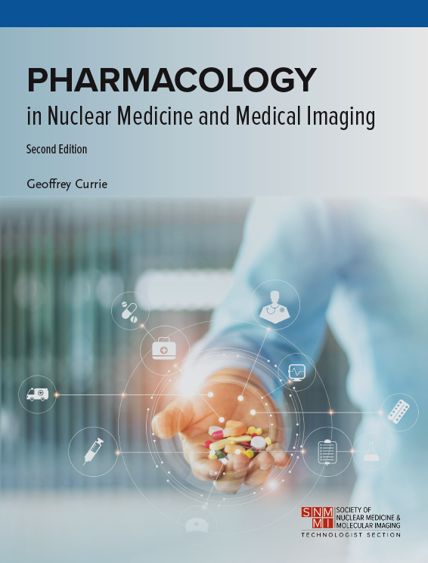
Now Available!
  Pharmacology Primer, 2nd ed
Tailored for nuclear medicine technologists and radiographers
Provides a concise, practice-oriented overview of pharmacology essentials
Covers indications, contraindications, warnings, precautions, drug interactions, and adverse reactions
Clear text with diagrams and references for further learning
Updated 2nd edition includes expanded content requested by program managers; new chapters cover with a broader range of imaging modalities and medications
Coming this fall

Slide 19


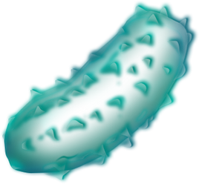

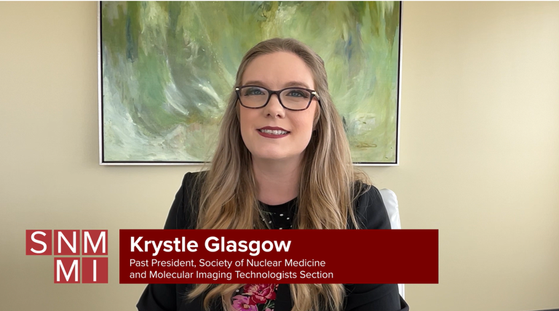
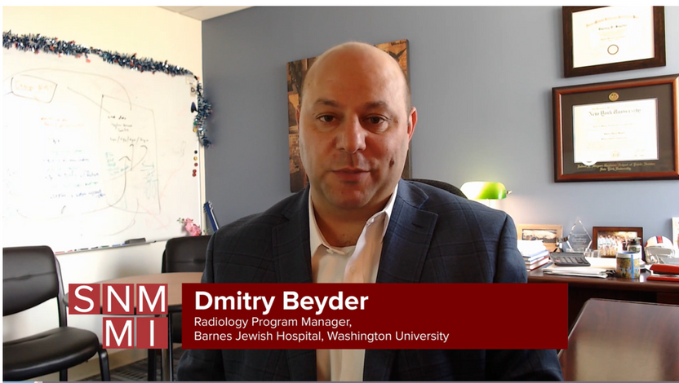
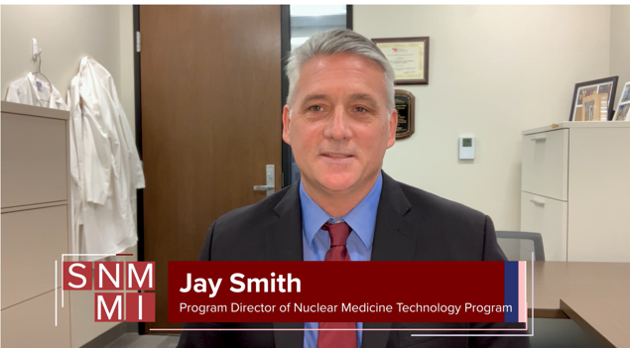
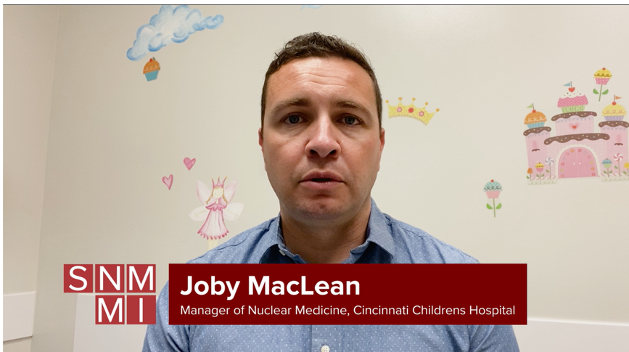
THERAPY MICRO VIDEOS
Member-Only Benefit
15 Completed To-Date!
UAB/SNMMI Therapy Intensive - Lessons Learned
Launching a Theranostics Program
Lutetium 177 Dotatate Administration
Pediatric Nuclear Medicine & Therapy

Slide 20

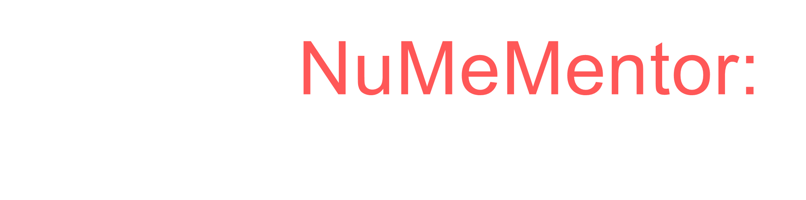
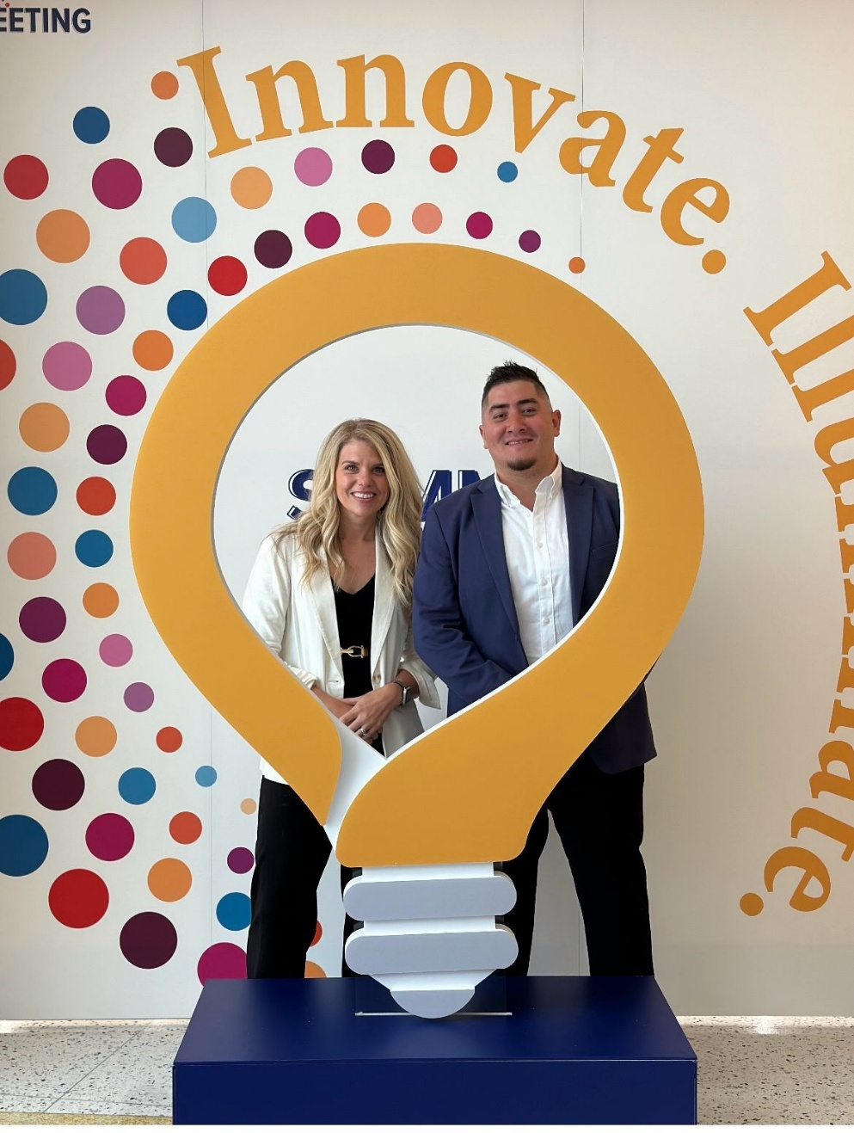
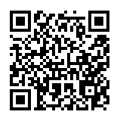
Refresh – What is NuMeMentor?
Roadblocks
Platform- MentorEase
Presentation
NuMeMentor Board
We want YOU to be a Mentor!
Sign up NOW!

Slide 21




Nuclear MAP
  Addressing Issues in Accessibility and Affordability of Education and Careers in Nuclear Medicine
October – December 2024
March – April 2025
As an SNMMITS initiative, we will work with educators, accreditors, partner organizations, and industry partners to identify strategies for outreach and education in rural communities and among underrepresented and underserved populations.

Slide 22


How to Participate in the Nuclear MAP
  Schedule a program with the school to share information on careers in nuclear medicine.
  Host a virtual workshop or seminar for teachers and career counselors to inform them about opportunities in Nuclear Medicine.
  Visit Your Legislator or Attend Capitol Hill Day
  Arrange public lectures or panel discussions featuring prominent figures in the field to draw community interest.

Slide 23

Recognition & Prizes
  Essay and Video Contest for Students – 5 @ $1,000 Awards
  Raffle for Members Participating as Ambassadors – Free Trip to 2025 Annual Meeting (flight, 4 nights hotel and registration)

Slide 24
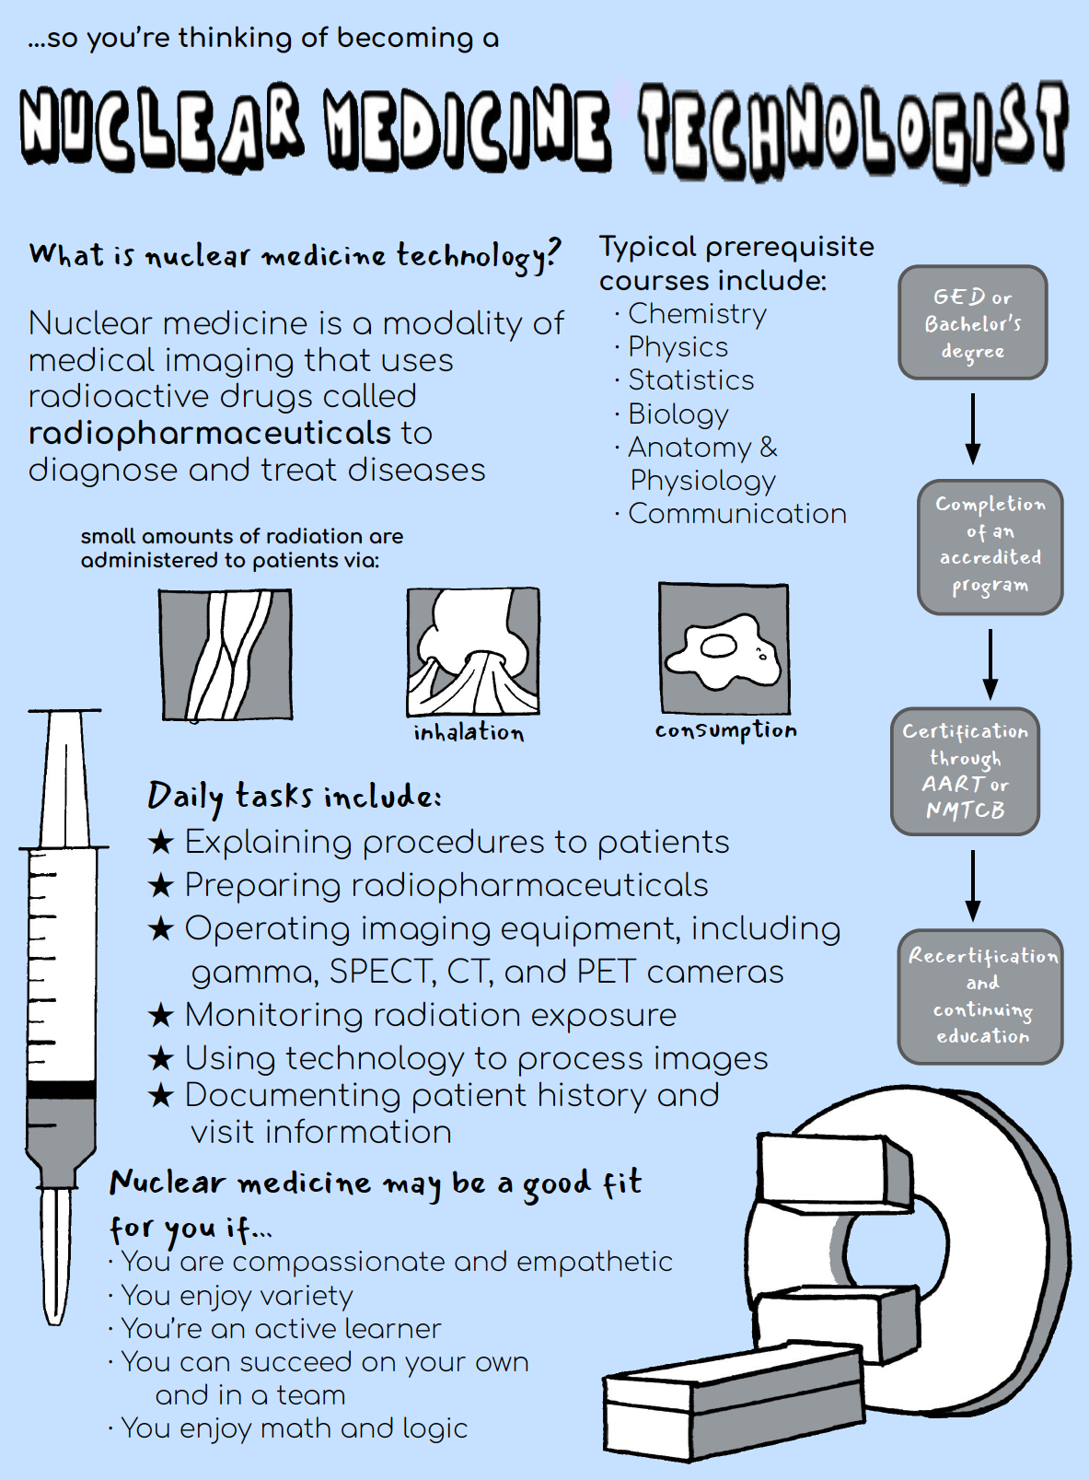
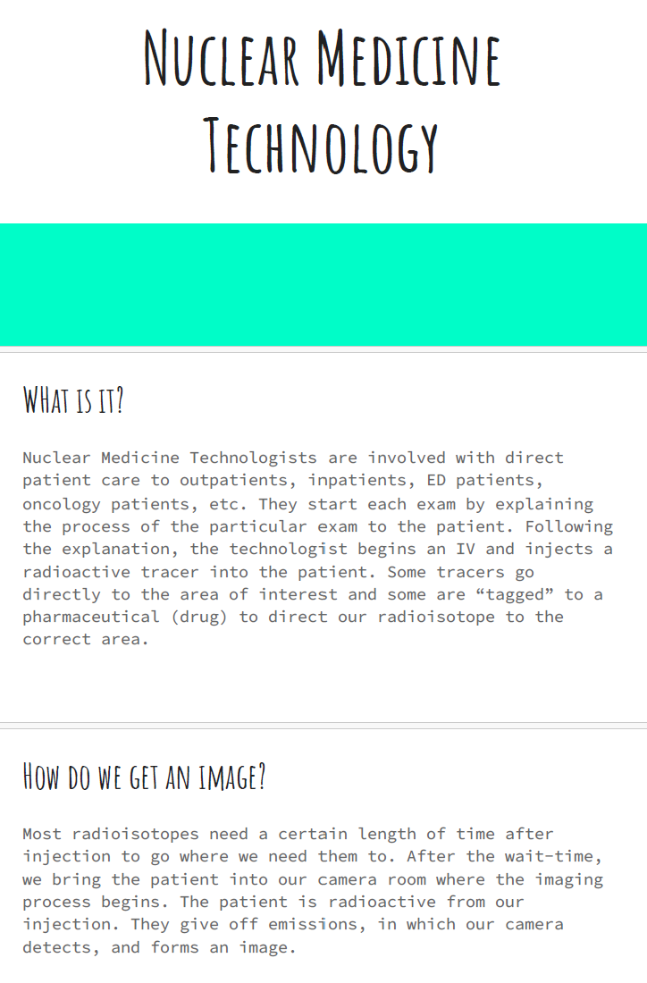
Nuclear MAP Student Contest Winners
Skylar Etten, University of Iowa
“The ability to help diagnose and treat diseases through this cutting-edge technology has given me a sense of purpose and a desire to contribute to its progress. Nuclear medicine has also allowed me to combine my passion for chemistry and healthcare [...]”
Brooke McKenney, Massachusetts College of Pharmacy and Health Sciences
Allison Mitola, Northwestern Memorial Hospital NM Schools
Alec Bergstad, Kaiser Permanente School of Allied Health
“Everything that I have learned thus far from instructors, technologists, and physicians, has been vital in my journey into nuclear medicine. Seeing therapy patients with a good response is one of the most rewarding things that I have encountered so far while learning in the clinical setting.”
Sean Dang, Gateway Community College
“I began researching nuclear medicine and discovered a world where technology and healthcare intersect in the most innovative ways. The idea of using radioactive materials to diagnose and treat diseases was both thrilling and intellectually stimulating.”

Slide 25


NEW Entry Level Scholarship
6 @ $10,000 EACH
Scholarship for NEWLY Accepted Students
Application Open Date: January 27, 2025
Application Close Date: March 27, 2025
Award Notification Date: April 2025
Criteria for Intensive:
  A completed application.
  Current resume or curriculum vitae.
  Official transcripts of all formal education are issued directly from the institution's registrar office.
  An applicant statement not to exceed two pages.
  Scanned copy of associate, bachelor’s or Entry-Level Master's degree program acceptance.
  A professional recommender who can respond to a 15-question reference questionnaire regarding your character. (The recommender can be a professor, teacher, coach, counselor, etc.)
  Have a minimum cumulative GPA of 2.5 or better on a 4.0 grading scale.
Sponsored By:

Slide 26

Available Grants & Scholarships
  Mickey Williams Minority Scholarship - $2,500
  Paul Cole Technologist Scholarship - $1,000
  The Sipra and Gopal Saha Scholarship - $2,500
  Bradley-Alavi Student Fellowship - $3,000
  Medical & Science Student Research Grant - $5,000
  Bachelor’s/ Master’s Completion Scholarship - $4,000
www.snmmi.org/grants

Slide 27

Keep in the KNOW
Stay Connected w/ SNMMI-TS!

Slide 28
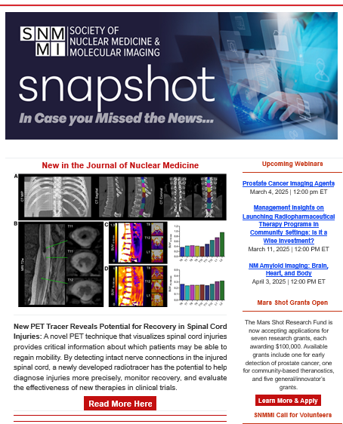
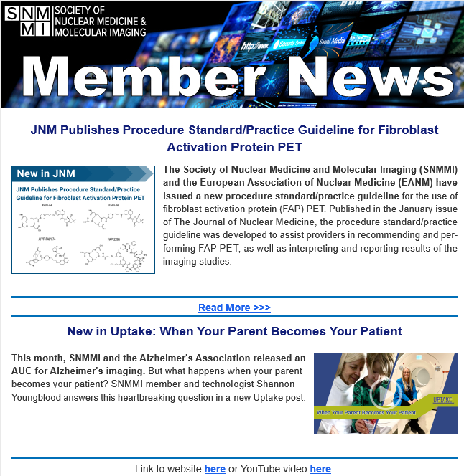
SNMMI Snapshot & Member News - Monthly

Slide 29
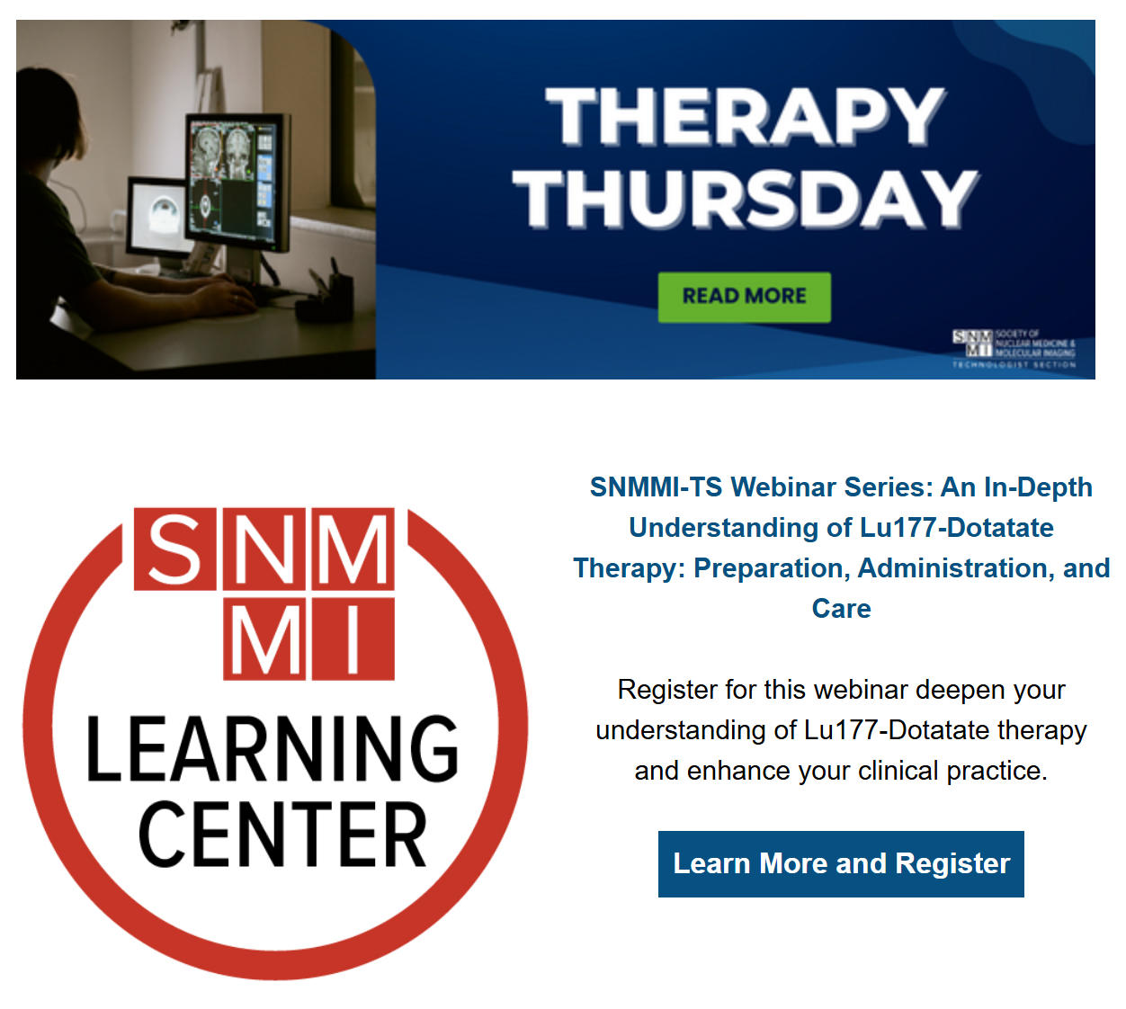
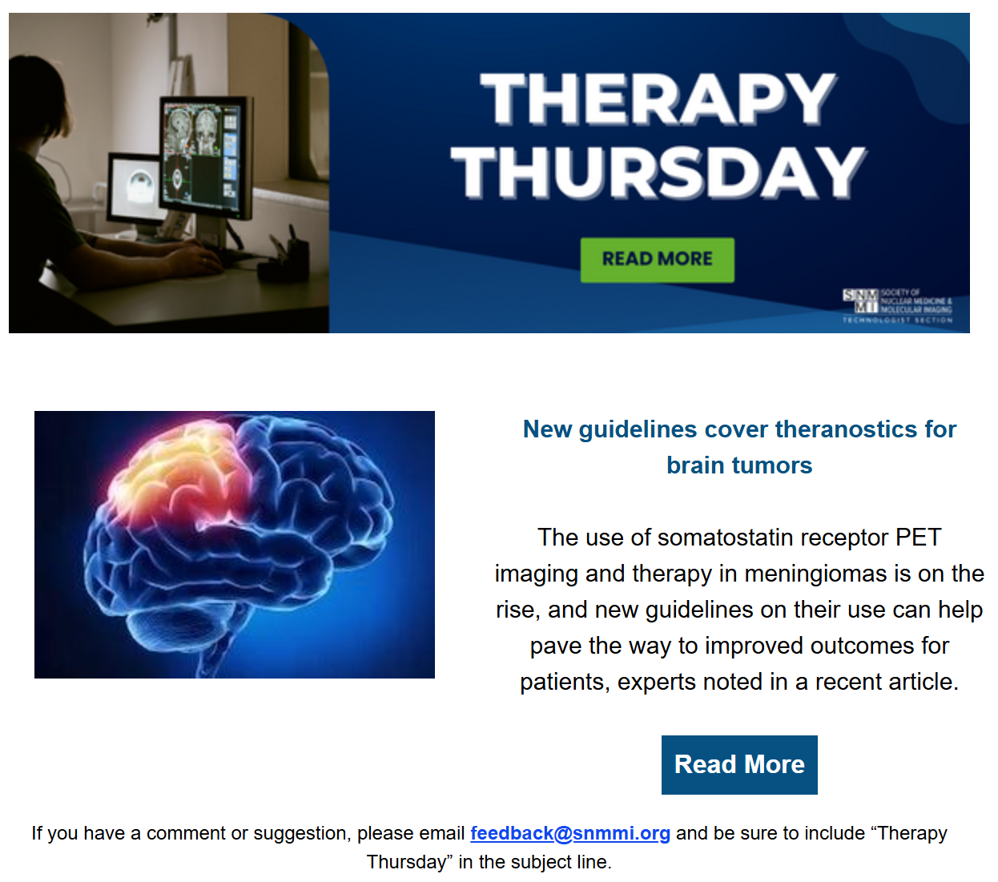
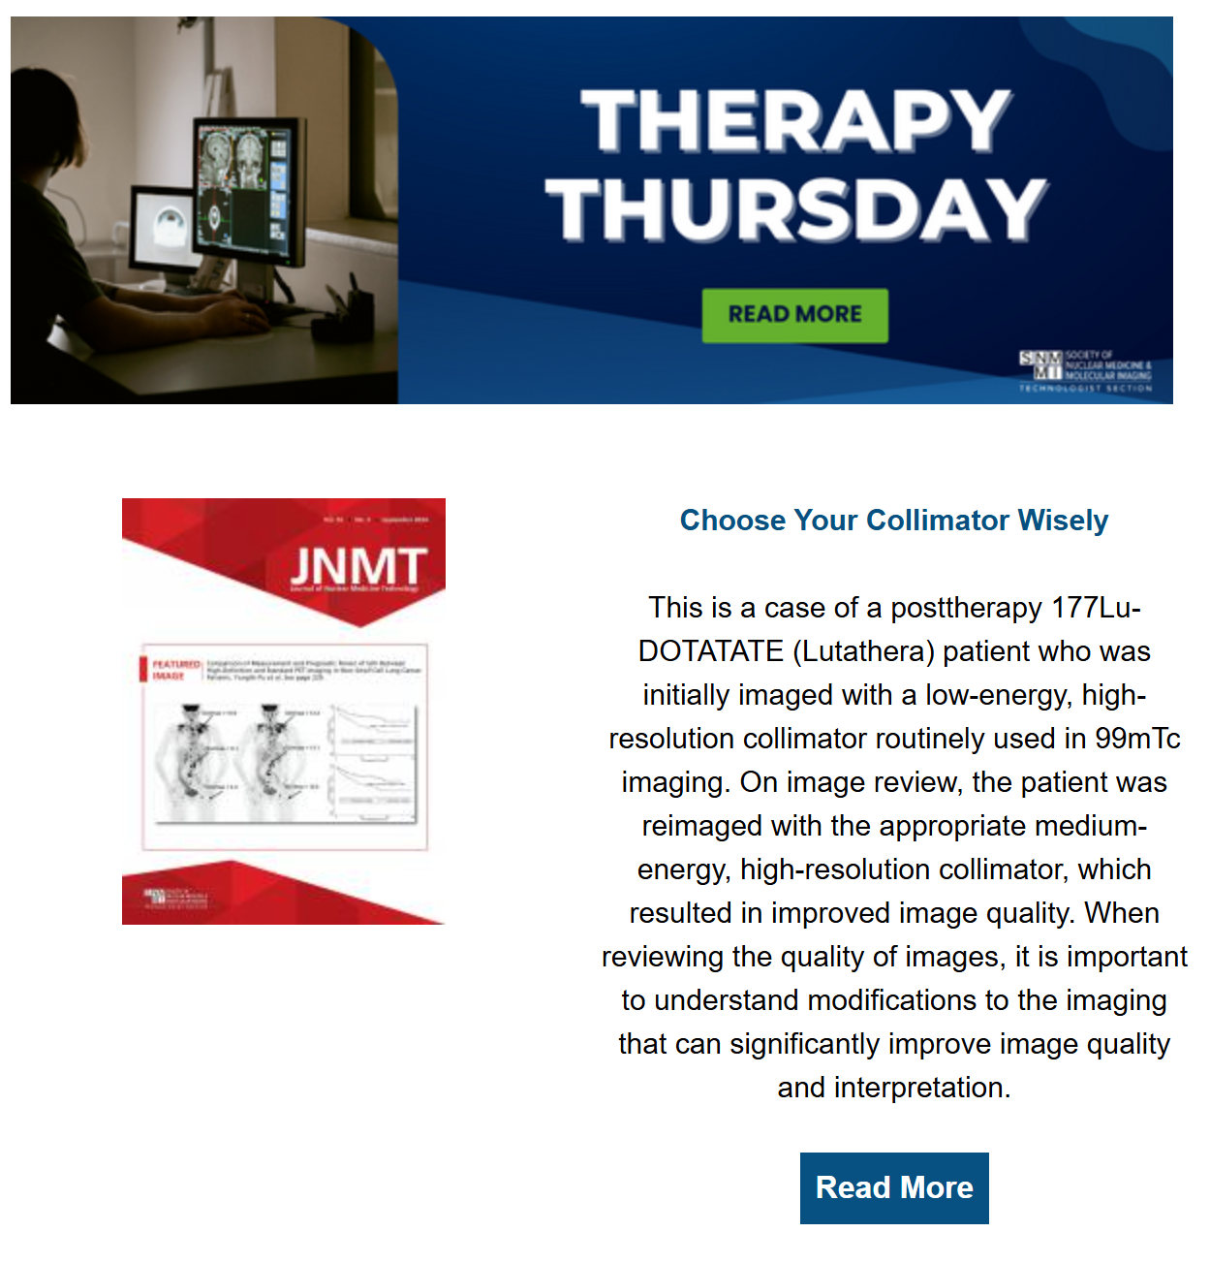
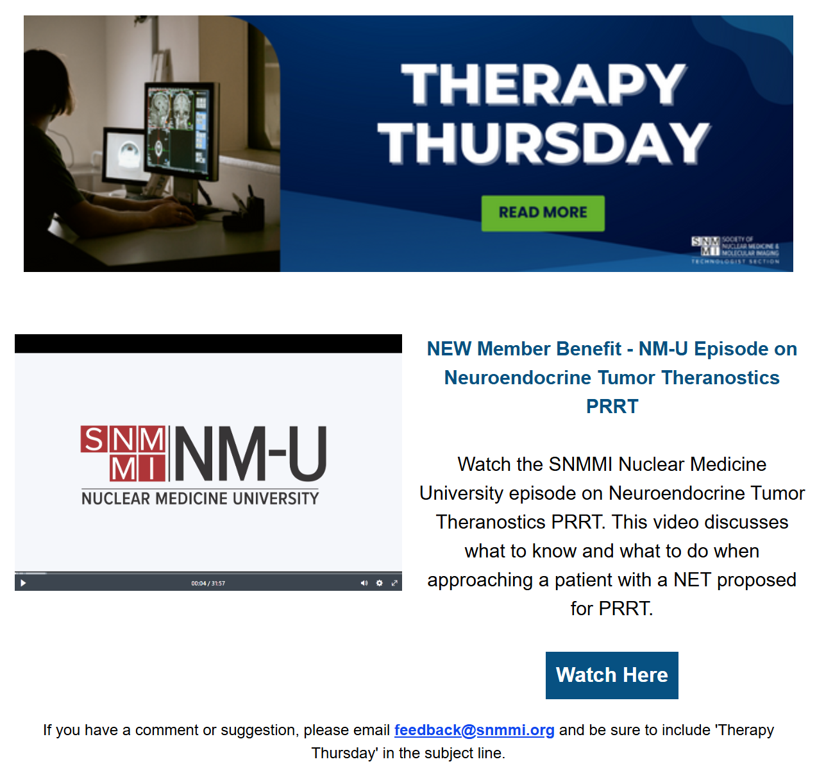
SNMMI-TS Therapy Thursdays
2024:
Relevant educational content, new member benefits, and news items.
Industry standard email open rates are 17%-28%. Therapy Thursday open rates consistently fall around the 50% open rate.
Continued interest and success throughout 2024
2025:
New interactive feature: members can email feedback@snmmi.org for comments and suggestions.
Pushing many NEW member benefits:
  NM-U videos
  Micro-Learning Videos
  New and relevant Learning Center courses/webinars

Slide 30
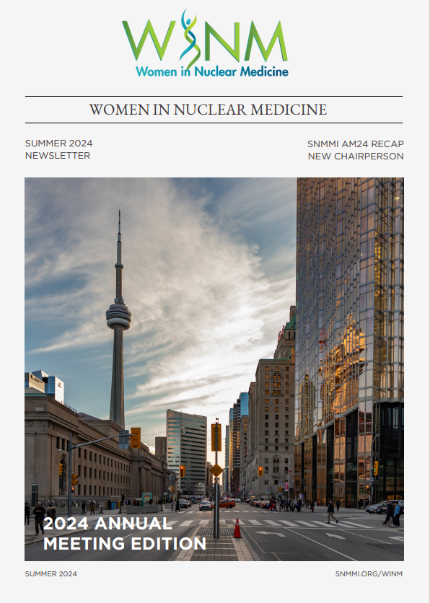
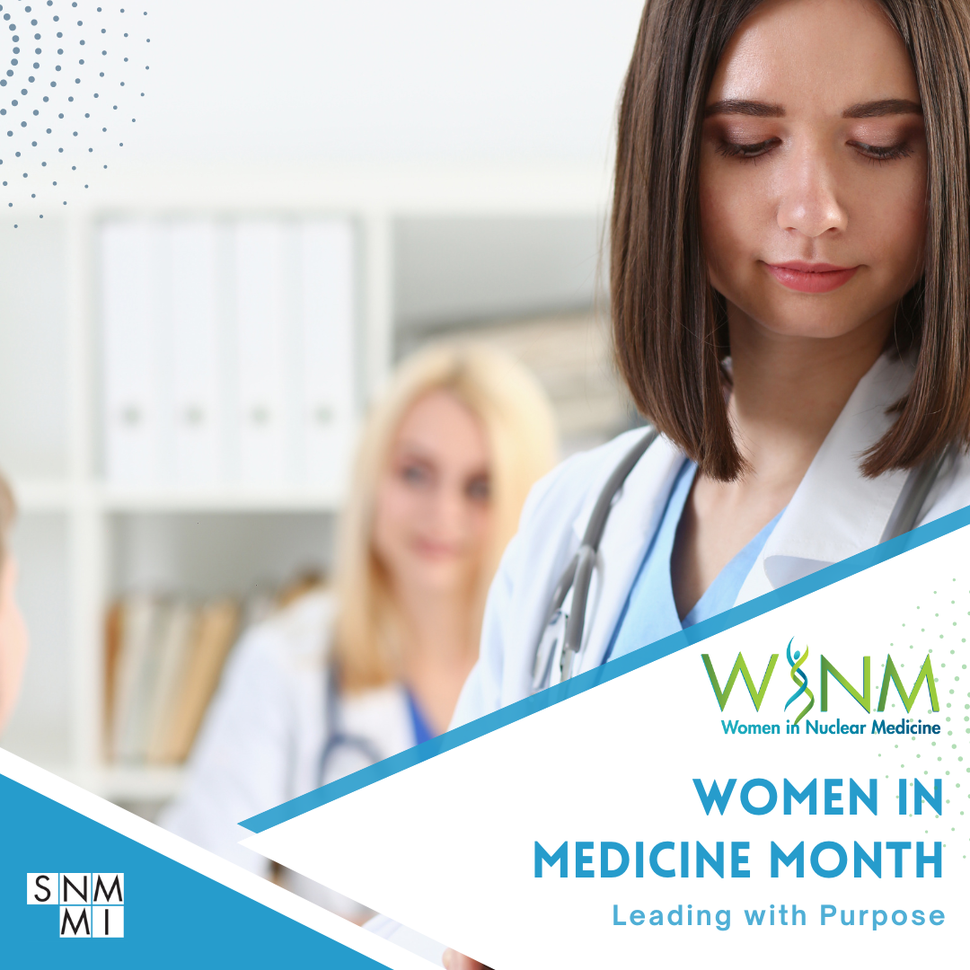
Women in Nuclear Medicine
September 2024

Slide 31
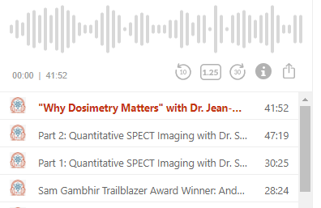
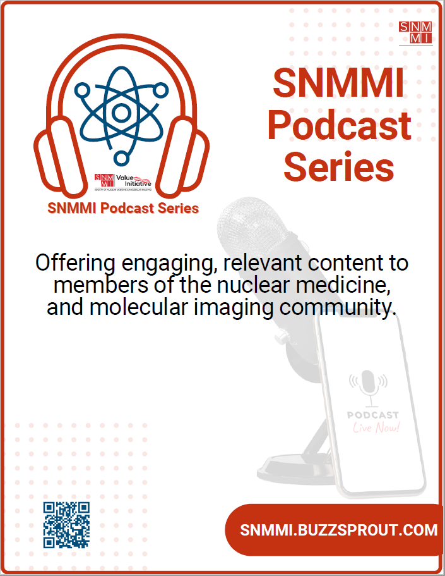
SNMMI Podcast Series

Slide 32






Like, Follow, Join & Subscribe
Like the SNMMI Facebook Page
www.facebook.com/mysnmmi
Follow @SNM_MI on Twitter
Join the SNMMI LinkedIn Group by searching Society of Nuclear Medicine and Molecular Imaging
Subscribe to SNMChannel1 on YouTube
Follow SNM_MI on Instagram

